Slide 1
ETG Project
Tracker
Streamlining Project Management with React, Spring Boot, and MySQL

Slide 2
TABLE OF CONTENTS
01
02
Project Stages
About the Project
03
04
Technologies Required
Project Goals
05
06
Sneak Peek
Timeline

Slide 3
ABOUT THE PROJECT
The ETG Project Tracker is a comprehensive project management application that helps teams streamline their workflow and collaborate effectively. Built using cutting-edge technologies like React, Spring Boot, and MySQL, the application offers a user-friendly interface and powerful features to manage projects, tasks, and team members. With its robust architecture and scalable design, the ETG Project Tracker is the perfect solution for businesses looking to optimize their project management processes.

Slide 4
PROJECT STAGES
STEP 2
STEP 1
STEP 3
Execution and Monitoring
Initiation and Planning
Closure and Review

Slide 5
TECHNOLOGIES REQUIRED
BACKEND
FRONTEND
DATABASE
Spring Boot, Spring Data JPA
React, React Router, Axios
SQL

Slide 6
OUR GOALS
VISIBILITY
COLLABORATION
EFFICIENCY
Provide a centralized platform for better project visibility and informed decision-making.
Facilitate seamless team collaboration through real-time updates, communication, and file sharing.
Streamline project management processes and automate repetitive tasks for improved productivity.

Slide 7
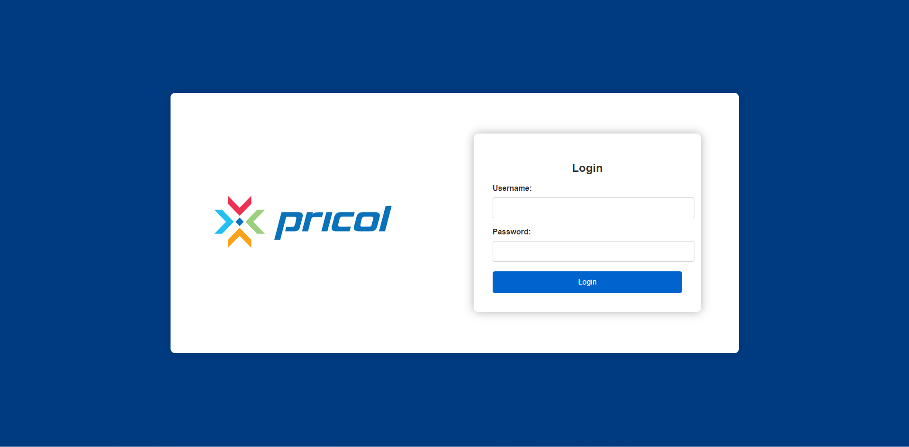
SNEAK PEEK
LOGIN CONTAINER
LOGO

Slide 8
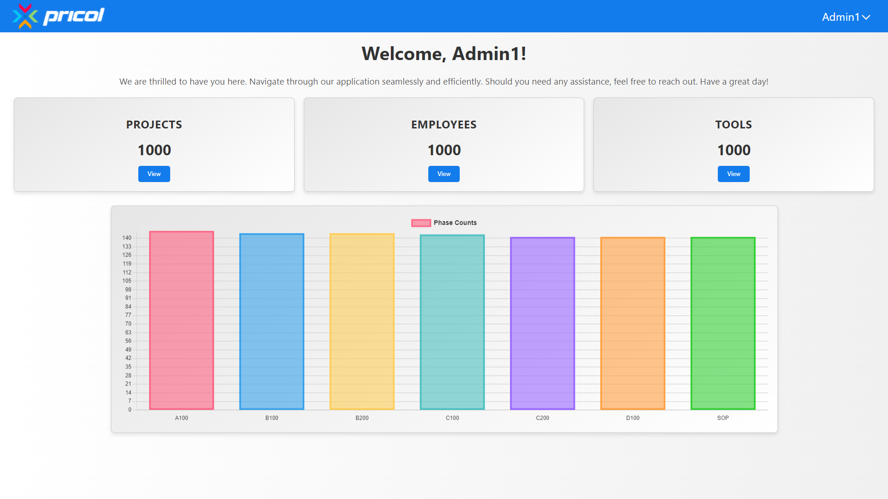
SNEAK PEEK
BUTTON TO VIEW THE TABLE
HEADER
CHART
DASHBOARD

Slide 9
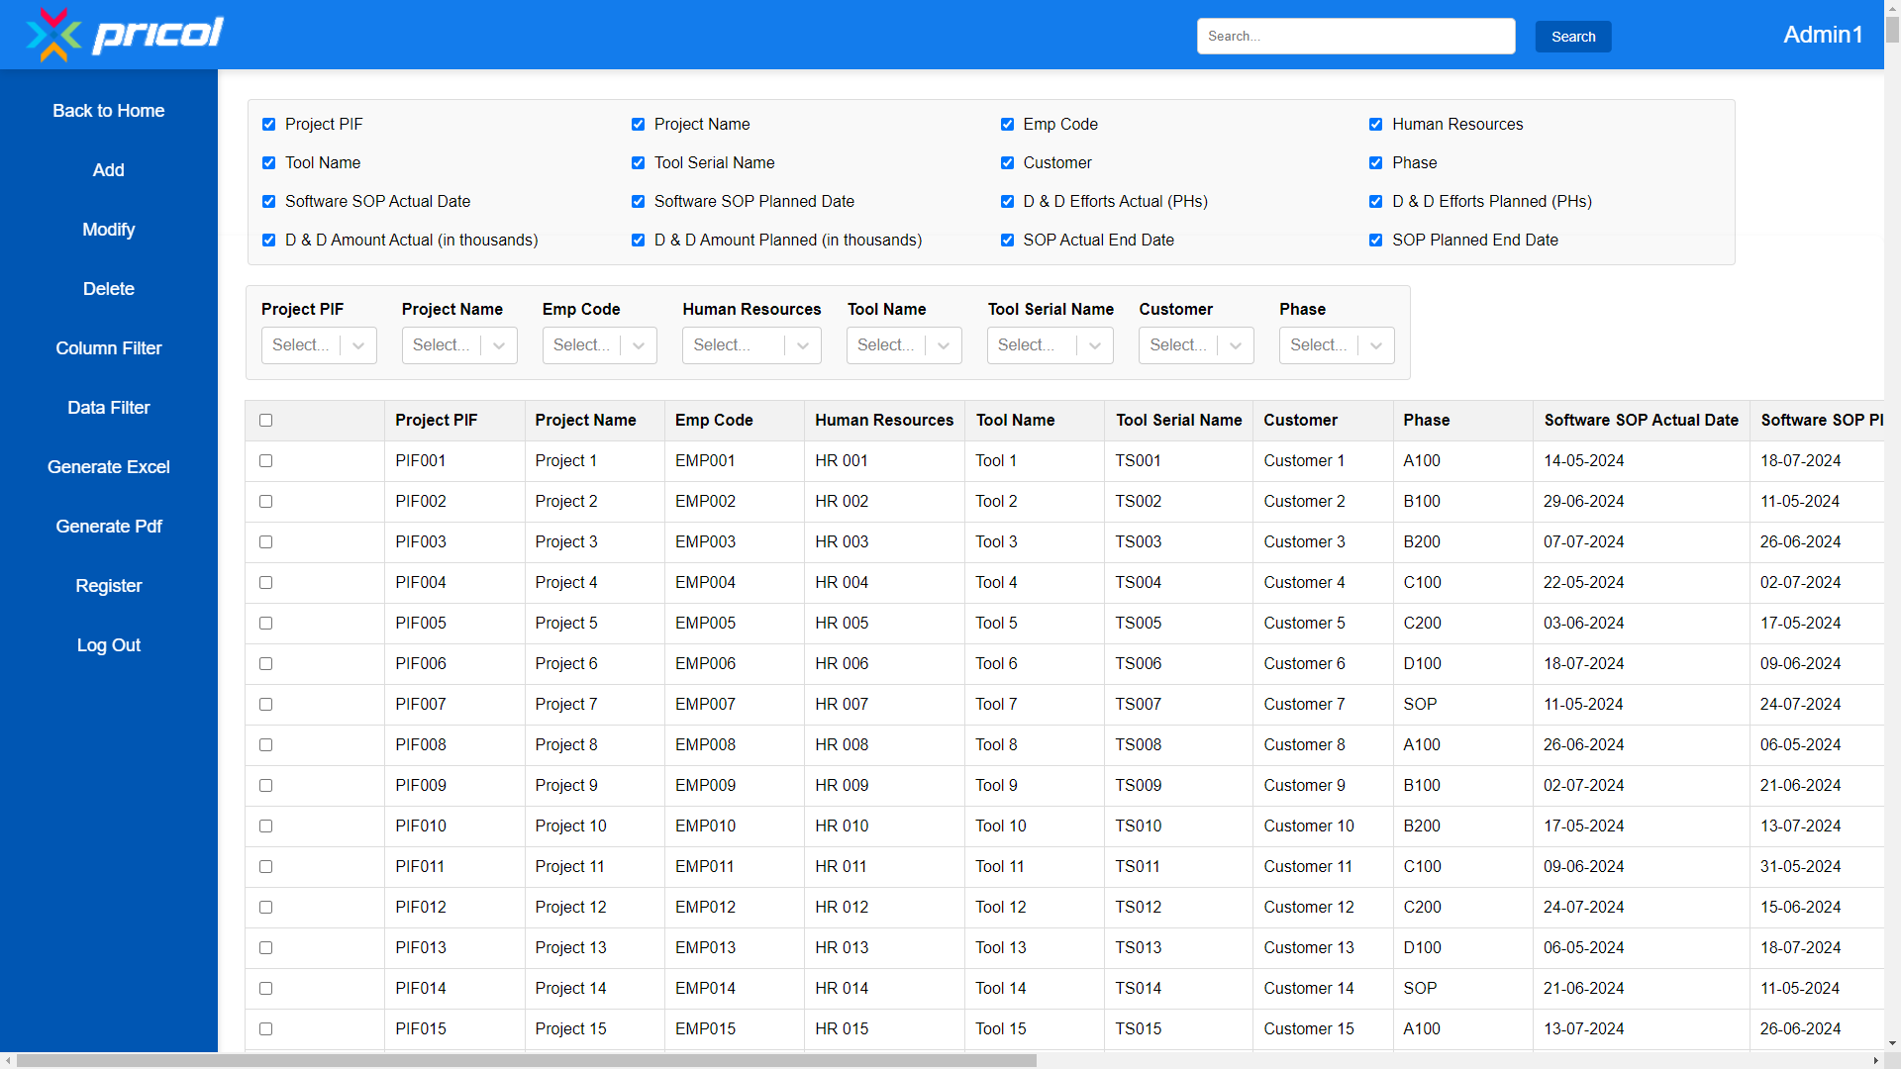
SNEAK PEEK
HEADER
TABLE
NAVBAR
COLUMN FILTER
DATA FILTER

Slide 10
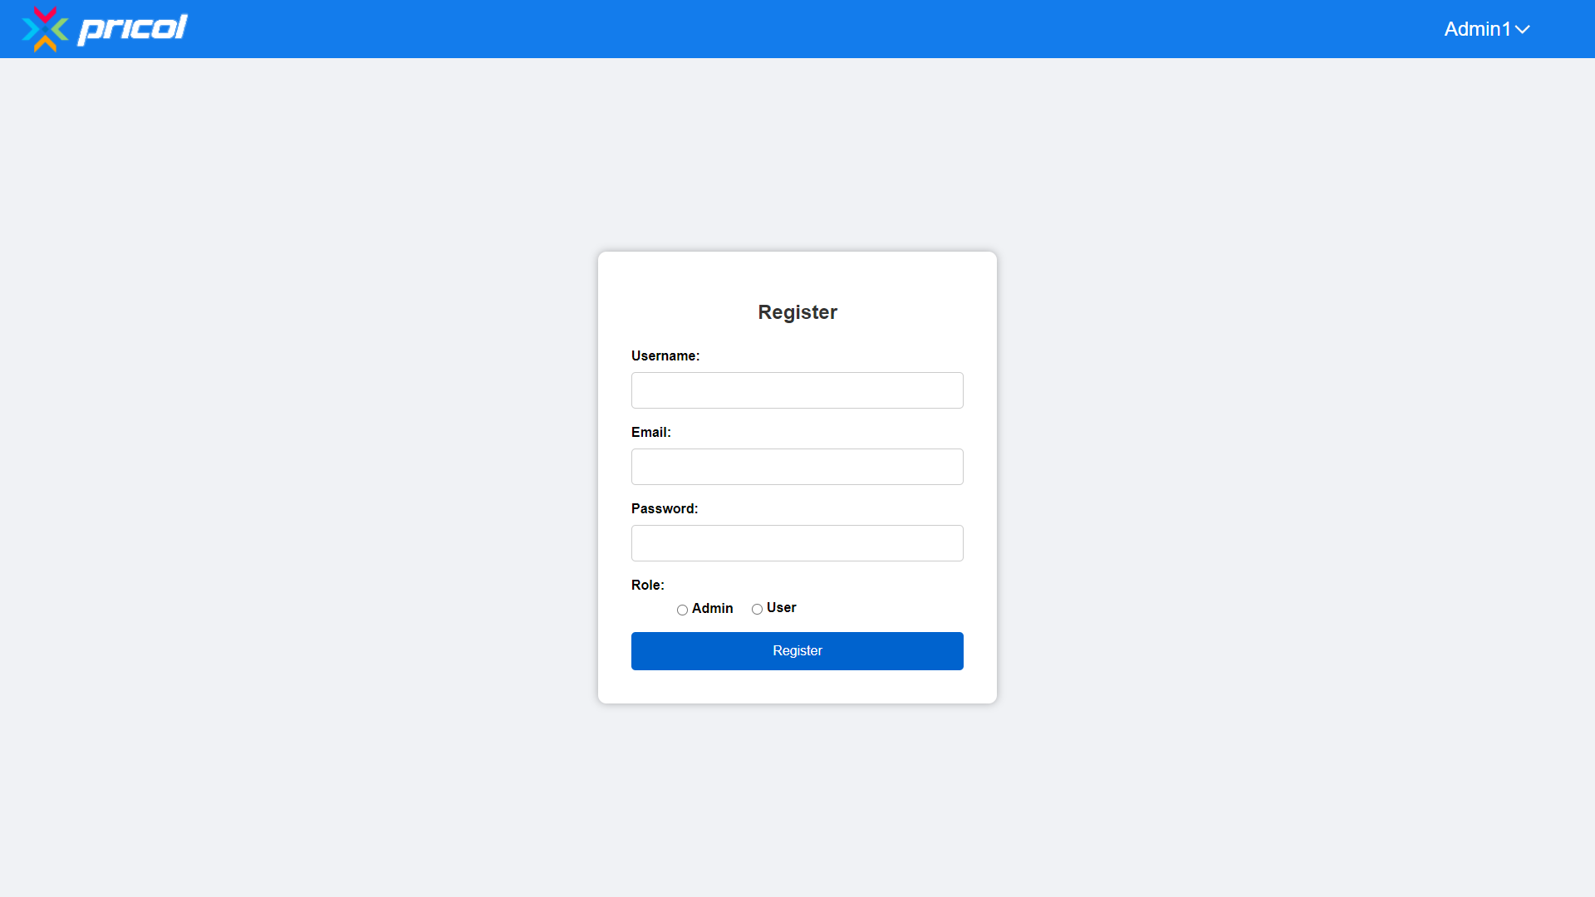
SNEAK PEEK
HEADER
REGISTRATION CONTAINER

Slide 11
OUR TIMELINE
WEEK 1
WEEK 3
FINAL
VERSION
WEEK 2
WEEK 4
Developing Backend
Refining the UI
Initiation and
plan
Develoing FrontEnd
Test and Review

Slide 12
THANKS!
Any Questions?
By:-
Abrohneel Roy
Intern

